Slide 1

MovieFlex
A database design for User interaction with movies
Submitted By
Group 5: Team Dark Queries
Ahnaf Iqbal - 19101024
Md Mashrur Rahman Masfi - 23101182
Md Fahad Hasan Mahi - 23101186
Robayet Ismum - 23101189

Slide 2

🎯 Project Goal
Movie database
View, rate, track
Normalized tables
Easy access

Slide 3
📄 Table Descriptions
Users: user_id, name, email, join_date, subscription info
Movies: movie_id, title, genre_id, etc.
Genres: genre_id, genre_name
WatchHistory: tracks viewing activity
Ratings: user_id, movie_id, rating, review

Slide 4
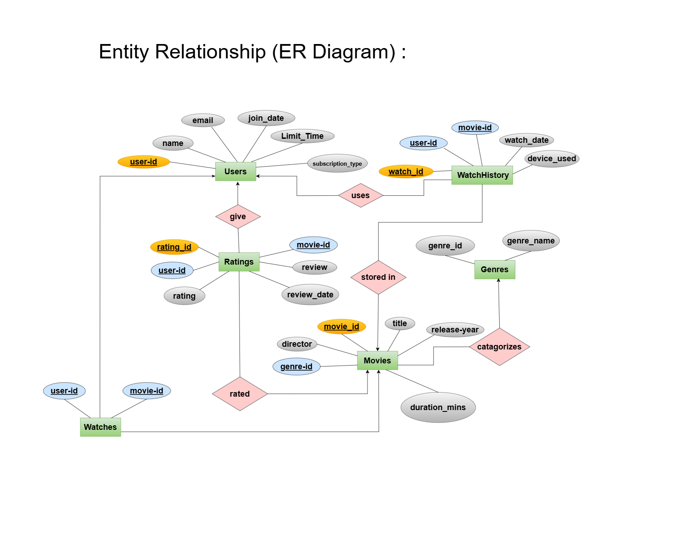
📘 ER Diagram

Slide 5
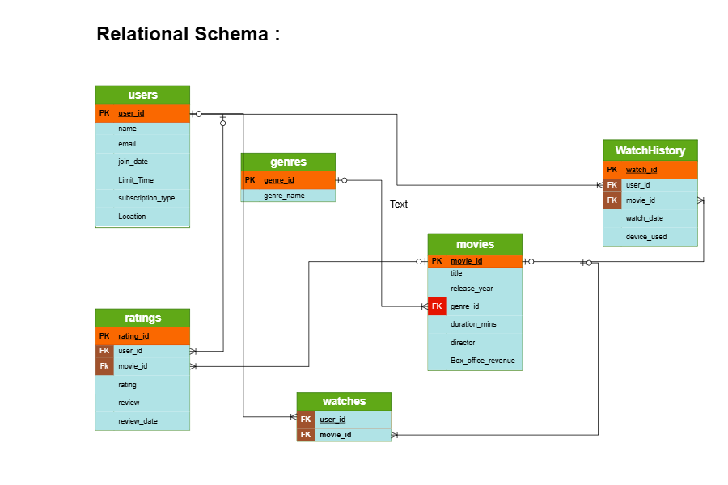
📐 Relational Schema

Slide 6
🧪 SQL Functionalities
Implemented SQL operations:
• CREATE TABLE, INSERT INTO, ALTER TABLE, UPDATE, DELETE
• JOIN operations to connect data
• WHERE clauses for conditional filters

Slide 7
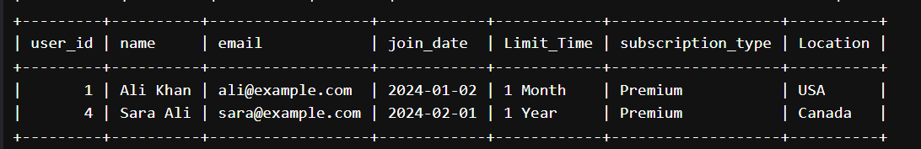
Queries Used in MySql……
Easy queires
-- 1) 1. Fetch all users who have a 'Premium' subscription and whose name contains 'Ali
SELECT * FROM Users
WHERE subscription_type = 'Premium' AND name LIKE '%Ali%' ;

Slide 8
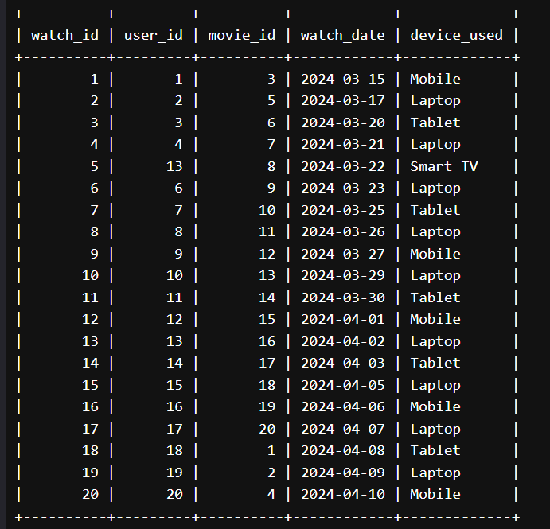
Queries Used in MySql……
-- 8) update the device to smart tv for id 5
UPDATE WatchHistory
SET device_used = 'Smart TV'
WHERE watch_id = 5;
SELECT * FROM WatchHistory;

Slide 9
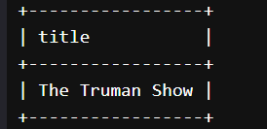
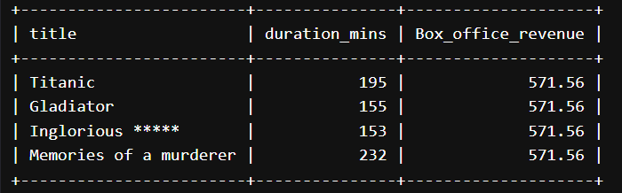
Queries Used in MySql……
-- Moderate queries
-- 1) fetch all movie titles user-id 9 has watched
SELECT title FROM Movies
WHERE movie_id IN (SELECT movie_id FROM WatchHistory WHERE user_id = 9);
-- 2) fetch movie title which duration are over 150 minute and over 500 million Box_office_revenue
SELECT title, duration_mins, Box_office_revenue
FROM Movies
WHERE duration_mins > 150 AND Box_office_revenue > 500;

Slide 10
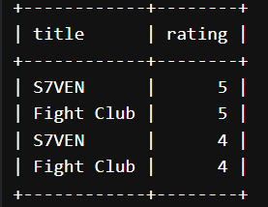
Queries Used in MySql……
-- 3)Cross product between title of movies and rating of Ratings table of both's movie id 9 and 10
SELECT Movies.title, Ratings.rating
FROM Movies
CROSS JOIN Ratings
WHERE Movies.movie_id IN (9, 10) AND Ratings.movie_id IN (9, 10) ;
-

Slide 11
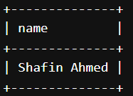
Queries Used in MySql……
-- 5) Fetch all users who have rated "The Matrix" higher than 4
SELECT name
FROM Users
WHERE user_id IN (SELECT user_id FROM Ratings WHERE movie_id = 1 AND rating > 4);

Slide 12
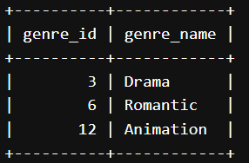
Queries Used in MySql……
-- 7) find name where contains ma
SELECT genre_id, genre_name
FROM Genres
WHERE genre_name LIKE '%ma%';

Slide 13
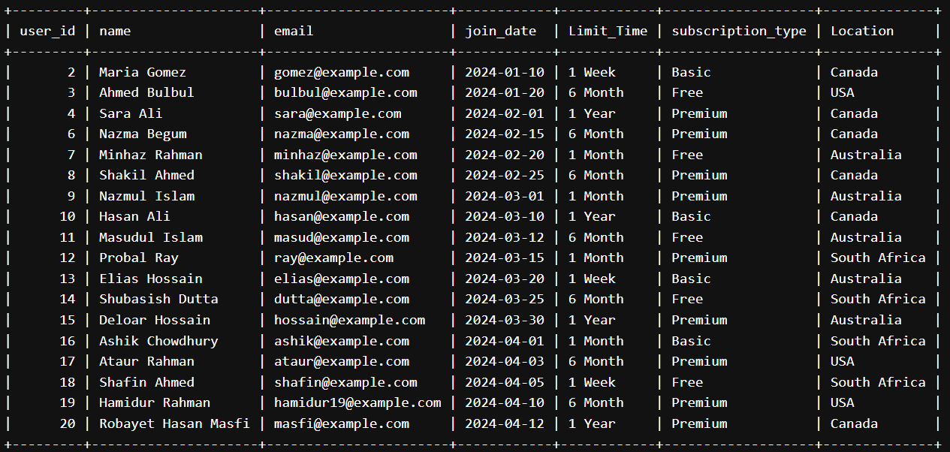
Queries Used in MySql……
-- Advanced queries
-- 1) List of Users Who Joined
After the First User from the USA
SELECT * FROM Users
WHERE join_date > (
SELECT join_date
FROM Users
WHERE Location = 'USA'
ORDER BY join_date ASC
LIMIT 1)
ORDER BY join_date ASC;

Slide 14
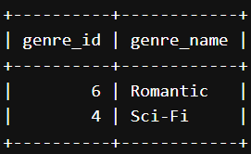
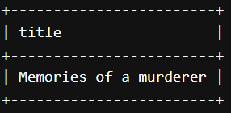
Queries Used in MySql……
-- 3) Genres that are linked to at least one movie directed by someone who directed “Titanic”
SELECT * FROM Genres
WHERE genre_id IN (
SELECT DISTINCT genre_id FROM Movies
WHERE director = (SELECT director
FROM Movies WHERE title = 'Titanic'));
-- 4) Movie that has highest duration
SELECT title FROM Movies
WHERE release_year = (
SELECT release_year FROM Movies
ORDER BY duration_mins DESC LIMIT 1
);

Slide 15
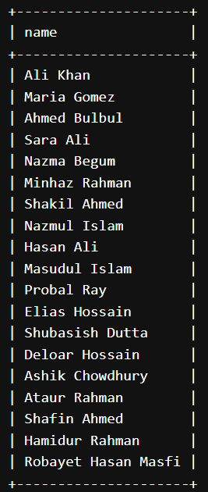
Queries Used in MySql……
-- 7) Find Users Who Watched a Movie But Never Rated It
SELECT DISTINCT u.name
FROM Users u
JOIN WatchHistory w ON u.user_id = w.user_id
LEFT JOIN Ratings r ON w.user_id = r.user_id AND w.movie_id = r.movie_id
WHERE r.rating IS NULL;
SELECT name FROM Users;

Slide 16
Copy this link for checking the full database creation
https://onecompiler.com/mysql/43h9244ad

Slide 17


